Slide 1
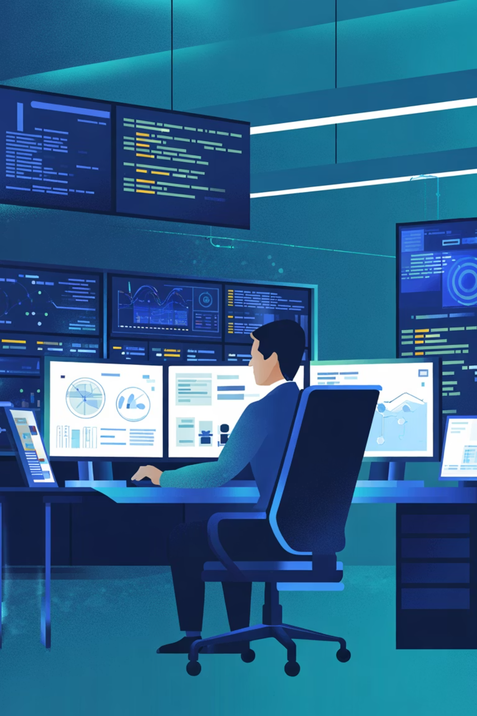
Cyber security
A comprehensive training resource for IT and security professionals covering threat landscapes, cloud security, network protection, and security operations.
B.Anu Bai
23501a1210
Information Technology

Slide 2
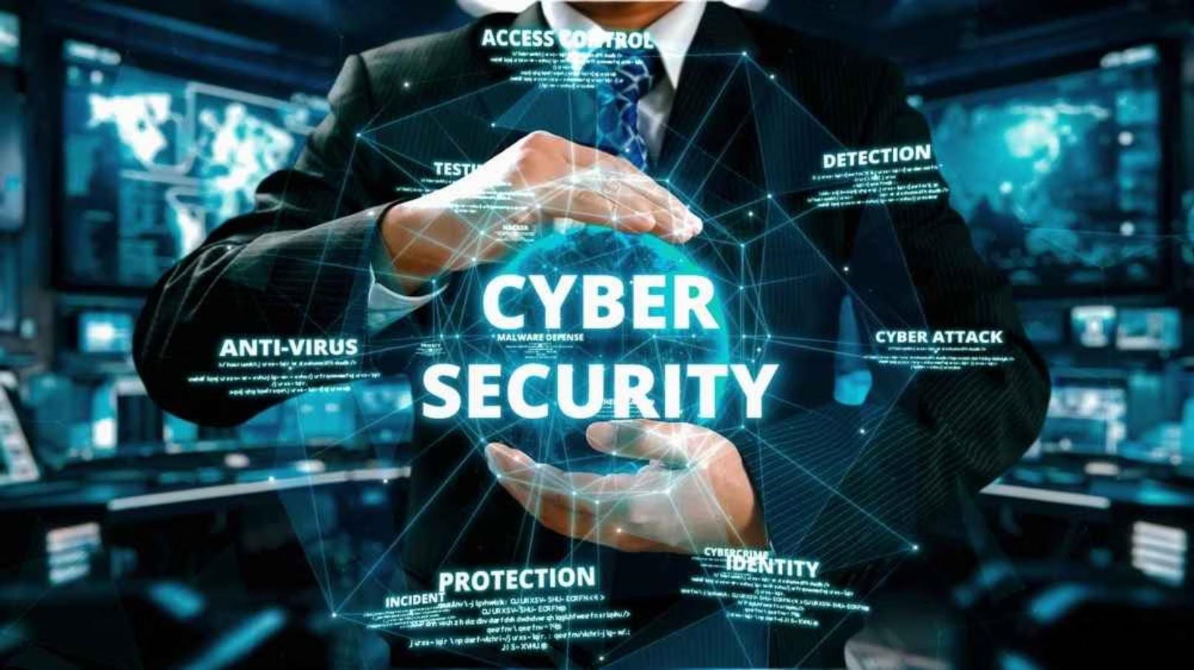












cyber security
Cyber Security is the practice of protecting computers, servers, mobile devices, networks, and data from malicious attacks. It focuses on safeguarding information systems against threats such as hacking, data breaches, malware, ransomware, phishing, and other cybercrimes.
In today’s digital world, where most activities—communication, banking, shopping, and even healthcare—depend on the internet, cyber security has become essential to ensure the confidentiality, integrity, and availability (CIA) of information.

Slide 3
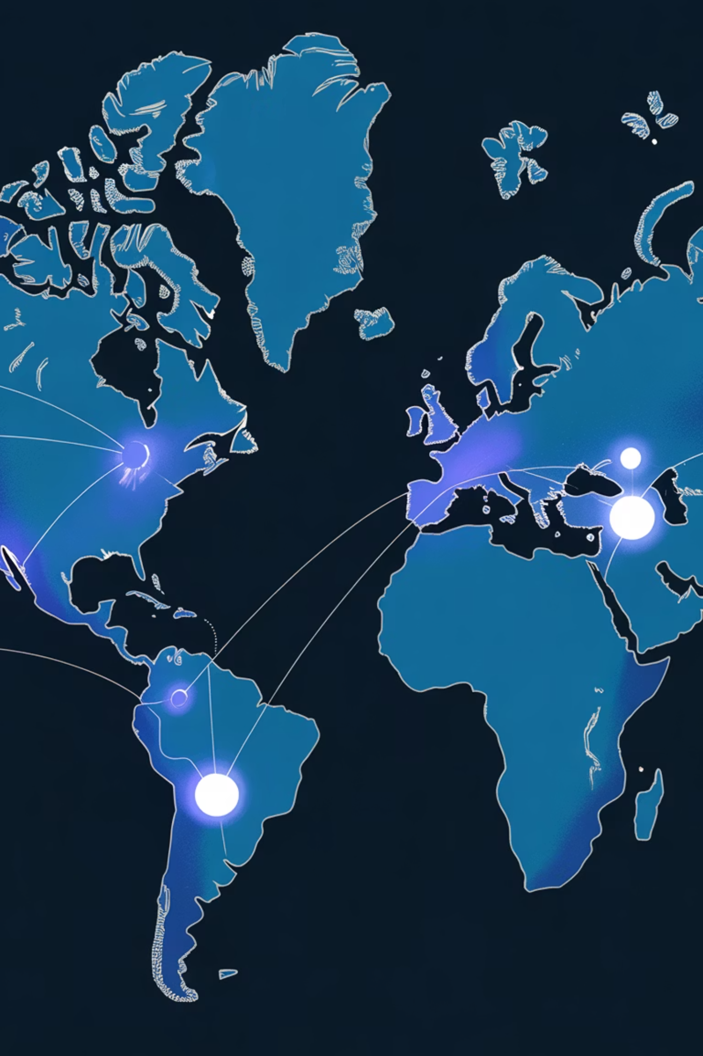



The Cyber Threat Landscape
Understanding the modern attack surface requires familiarity with diverse threat vectors and attacker methodologies. Organizations face increasingly sophisticated adversaries ranging from opportunistic threat actors to advanced persistent threats (APTs).
Attack Types
Attack Techniques
Malware and ransomware
Credential harvesting
Phishing campaigns
Privilege escalation
DDoS attacks
Lateral movement
Key Vulnerabilities
APTs targeting enterprises
WiFi security gaps
Unpatched systems

Slide 4
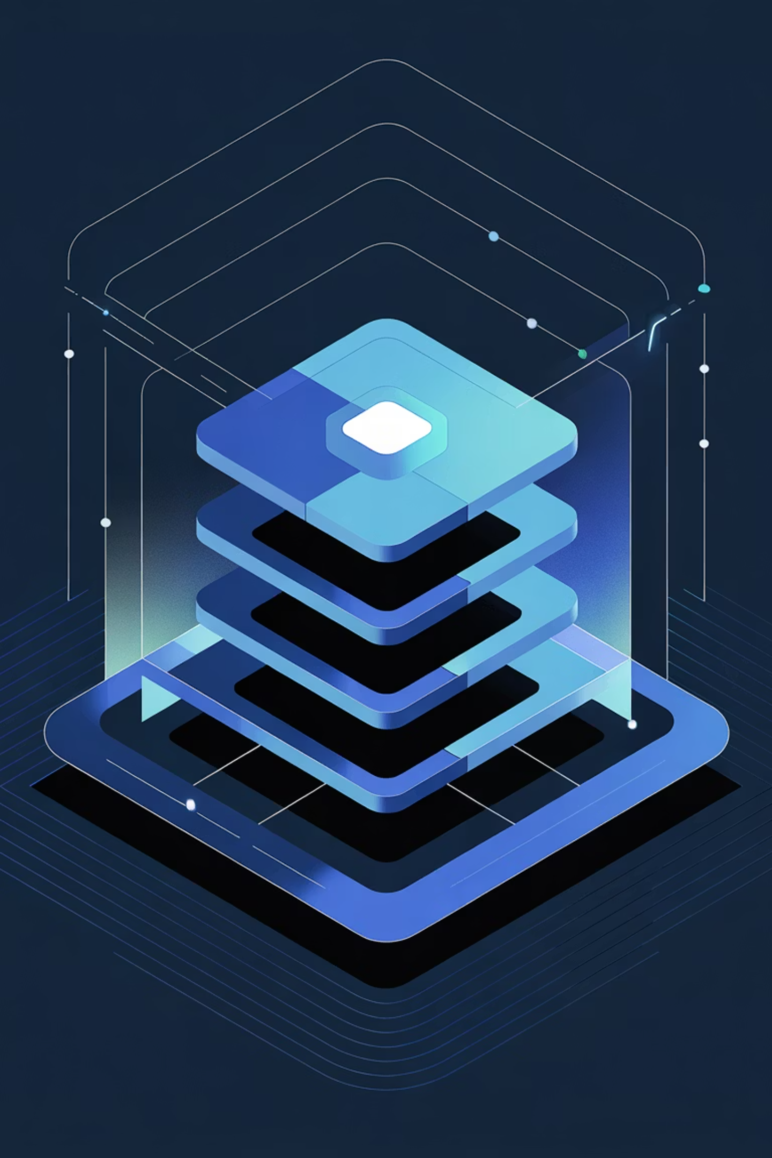





Security Models and Frameworks
Building Your Defense Architecture
Effective cybersecurity requires a structured approach. Security models provide the conceptual framework for defense-in-depth strategies, ensuring multiple layers of protection regardless of where attacks originate.
Prevention
Block threats before they reach systems through firewalls, intrusion prevention, and access controls.
Detection
Identify malicious activity in real time using monitoring tools and behavioral analysis.
Response
Contain and remediate incidents quickly to minimize damage and recovery time.
Recovery
Restore systems and data to normal operations while maintaining integrity and security.

Slide 5




Cloud Security Fundamentals
Cloud computing transforms infrastructure delivery, but introduces new security considerations. Modern cloud-native technologies require updated security approaches that address shared responsibility models and containerized workloads.
Cloud Computing Benefits
Security Considerations
Scalability and flexibility
Shared responsibility
Cost efficiency
Data residency requirements
Global accessibility
Compliance obligations
Reduced capital expenses
Identity and access management

Slide 6
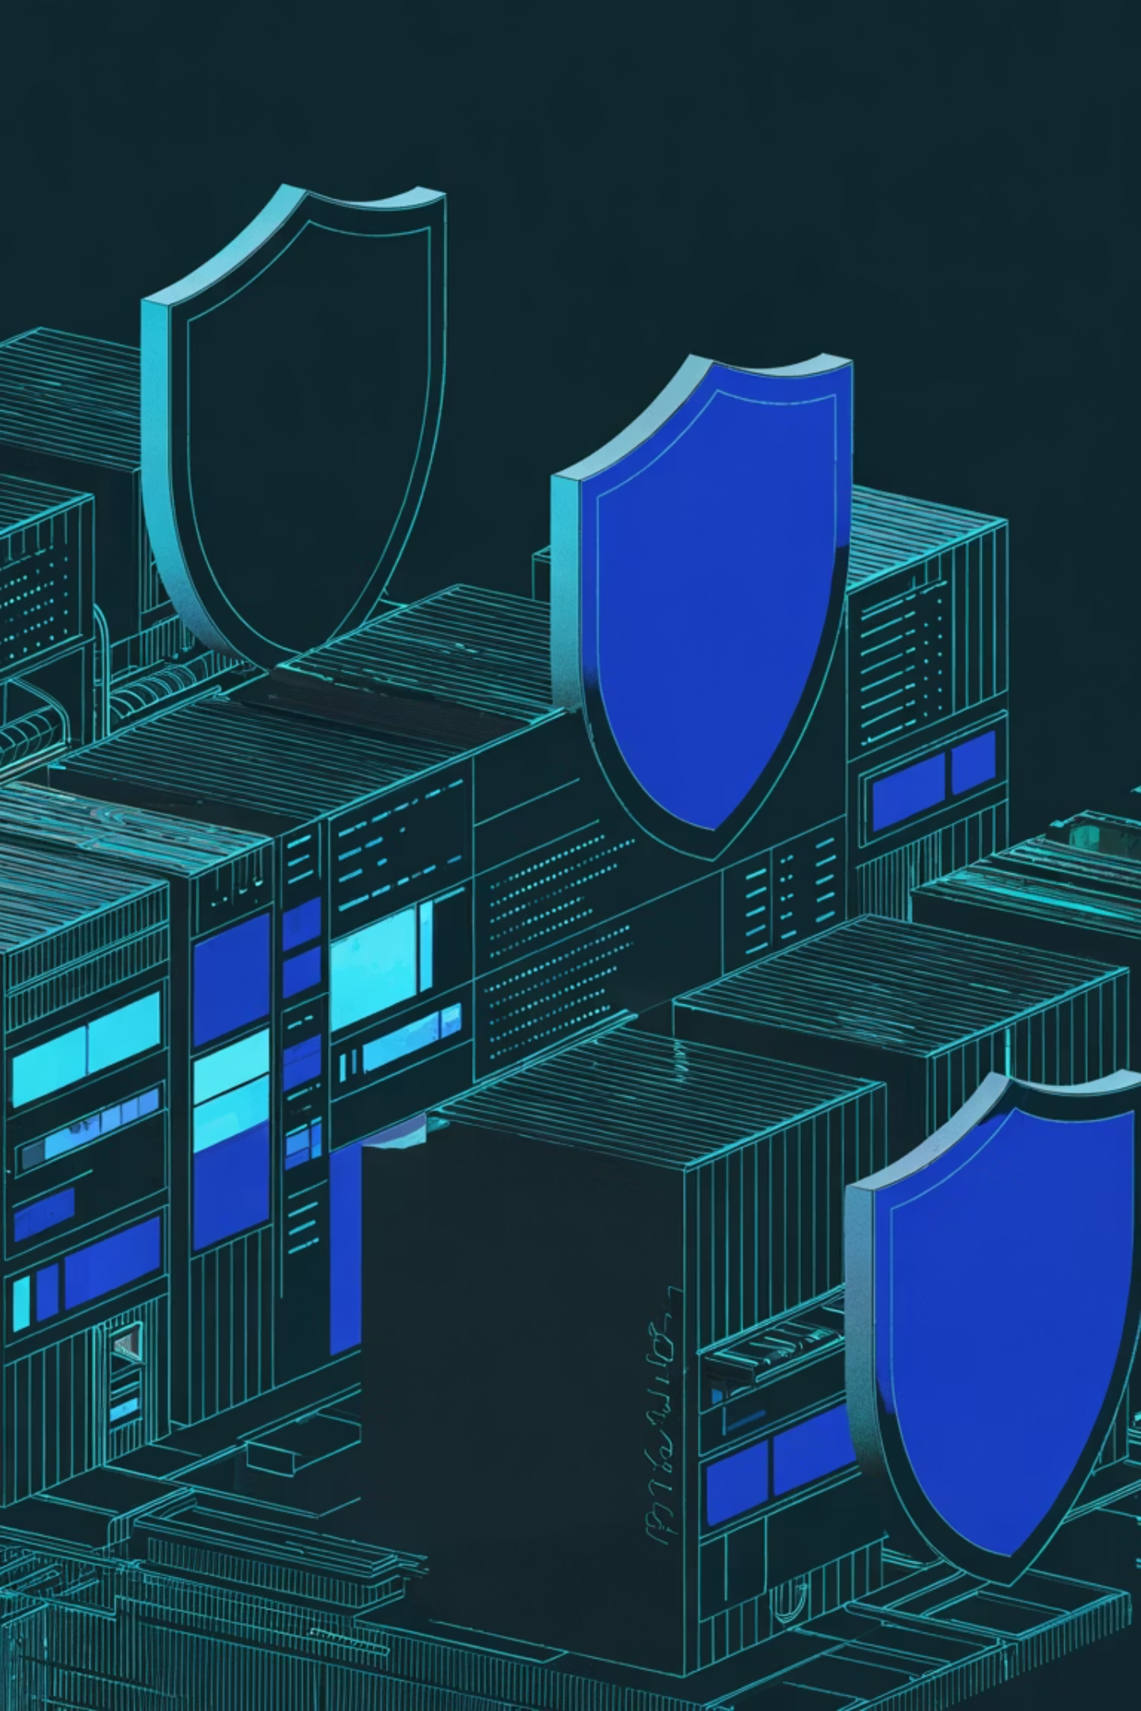

Cloud-Native Security Strategy
Protecting Modern Cloud Architectures
Cloud-native technologies like containers and microservices require evolved security strategies. Hybrid data center security bridges on-premises and cloud environments, while Zero Trust access solutions ensure secure connectivity regardless of location.
01
Cloud-Native Security
Implement container scanning, orchestration security, and runtime protection for microservices environments.
02
Hybrid Data Center
Maintain consistent security policies across on-premises infrastructure and cloud platforms.
03
SASE Architecture
Deploy Secure Access Service Edge (SASE) solutions like Prisma Access for unified security and networking.
04
SaaS and Cloud Workload Protection
Monitor and protect data across SaaS applications and cloud workloads with integrated visibility.

Slide 7








Network Security Essentials
Network security protects data in transit and controls access to critical assets. In today's connected global environment, comprehensive network security combines traditional technologies with modern endpoint and application-layer protection.
Connected Globe
Addressing & Encapsulation
Organizations operate across distributed networks requiring consistent security policies worldwide.
Understand IP routing, VLAN segmentation, and encrypted tunneling for secure communication.
Endpoint Protection
Network Technologies
Secure devices at network edges with advanced malware detection and behavioral analysis.
Deploy firewalls, intrusion detection, threat prevention, and DDoS protection systems.

Slide 8
Enterprise Network Defense
Securing the Connected Enterprise
Enterprise security requires coordinated defense across multiple domains. Network segmentation, zero-trust principles, and unified threat management create resilient protection against sophisticated adversaries.
Security Layer
Focus Area
Key Technologies
Perimeter
External threats
Firewalls, WAF, DDoS
Network
Internal movement
Segmentation, IDS/IPS
Endpoint
Device security
EDR, antivirus, MDM
Application
Data protection
Encryption, DLP, API security

Slide 9










Security Operations Center Fundamentals
The SOC serves as the command center for security operations. A mature SOC combines talented people, efficient processes, advanced technology, and complete visibility to detect, investigate, and respond to security incidents rapidly and effectively.
Processes
People
Standardized procedures for detection, investigation, escalation, and incident response.
Skilled analysts, engineers, and incident responders working 24/7 to protect assets.
Visibility
Complete monitoring of networks, endpoints, and applications through integrated sensors.
Interfaces
Communication channels with business units, IT teams, and external partners.
Technology
SIEM, analytics, threat intelligence, and automation tools for efficient operations.

Slide 10
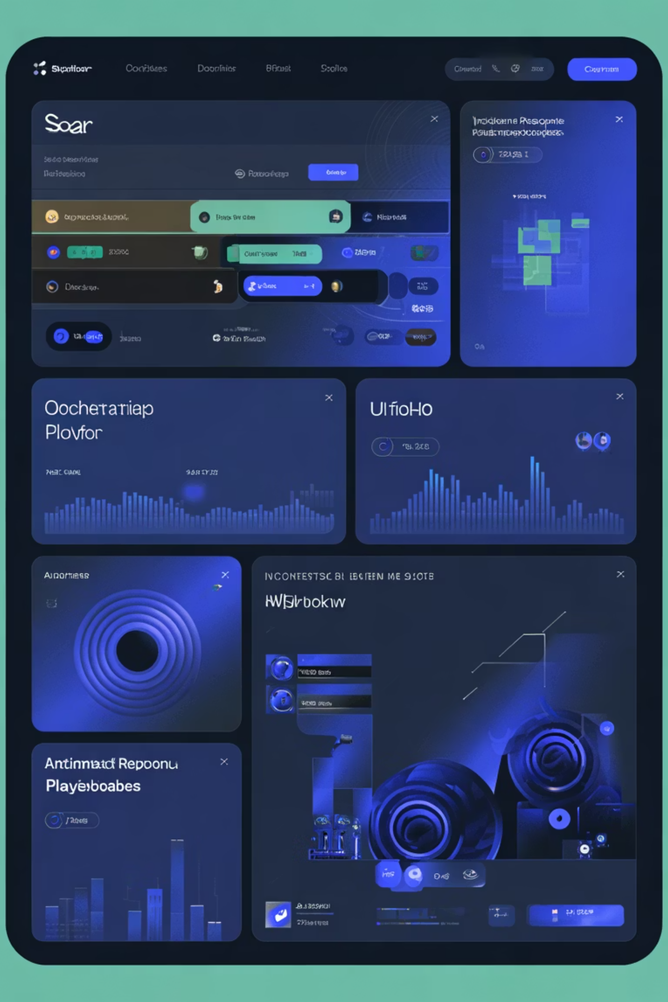
SOC Operations and Automation
A Day in the SOC: Detection to Resolution
SOC analysts face constant alerts requiring rapid triage and investigation. Security Orchestration, Automation and Response (SOAR) platforms dramatically improve efficiency by automating routine tasks, enriching alerts with threat intelligence, and streamlining investigation workflows.
1
Alert Ingestion
SOC receives alerts from firewalls, endpoints, cloud platforms, and application monitoring tools continuously.
2
SOAR Enrichment
Automation platforms correlate alerts, query threat intelligence, and contextualize potential incidents automatically.
3
Analyst Investigation
Analysts review prioritized incidents using playbooks that guide investigation and evidence collection.
4
Automated Response
SOAR executes containment actions—isolating hosts, blocking IPs, or disabling accounts—without manual delay.

Slide 11
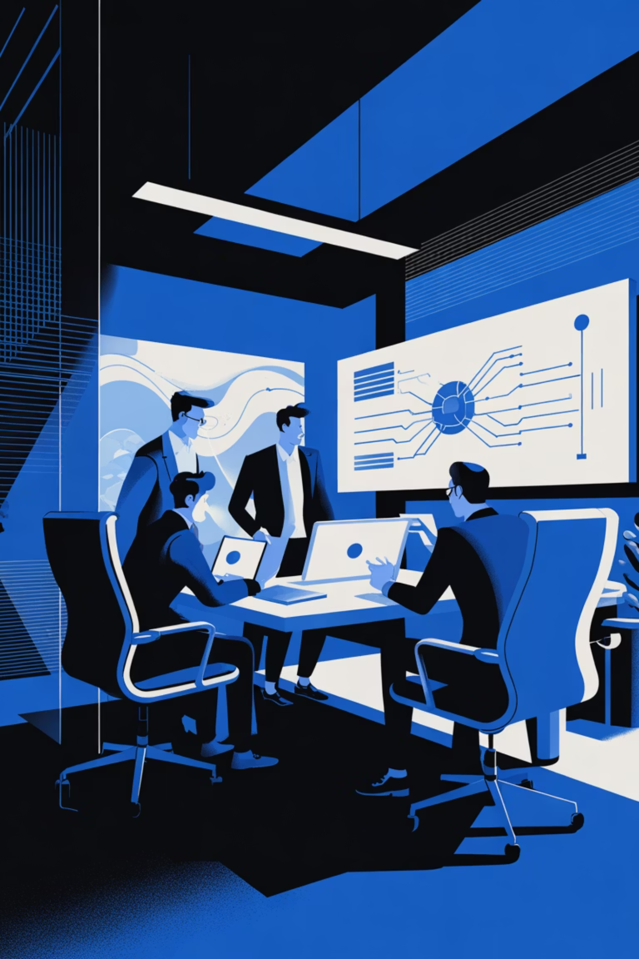
Building Your Security Program
Effective cybersecurity requires integration across all domains covered in this training: threat intelligence, cloud security, network defense, and SOC operations working together as a unified program.
Assessment
Evaluate current security posture and identify gaps in people, processes, and technology.
Strategy
Define security architecture aligned with business objectives and compliance requirements.
Implementation
Deploy controls, establish processes, and train personnel for consistent execution.
Operations
Continuously monitor, measure, and improve through metrics and incident insights.

Slide 12
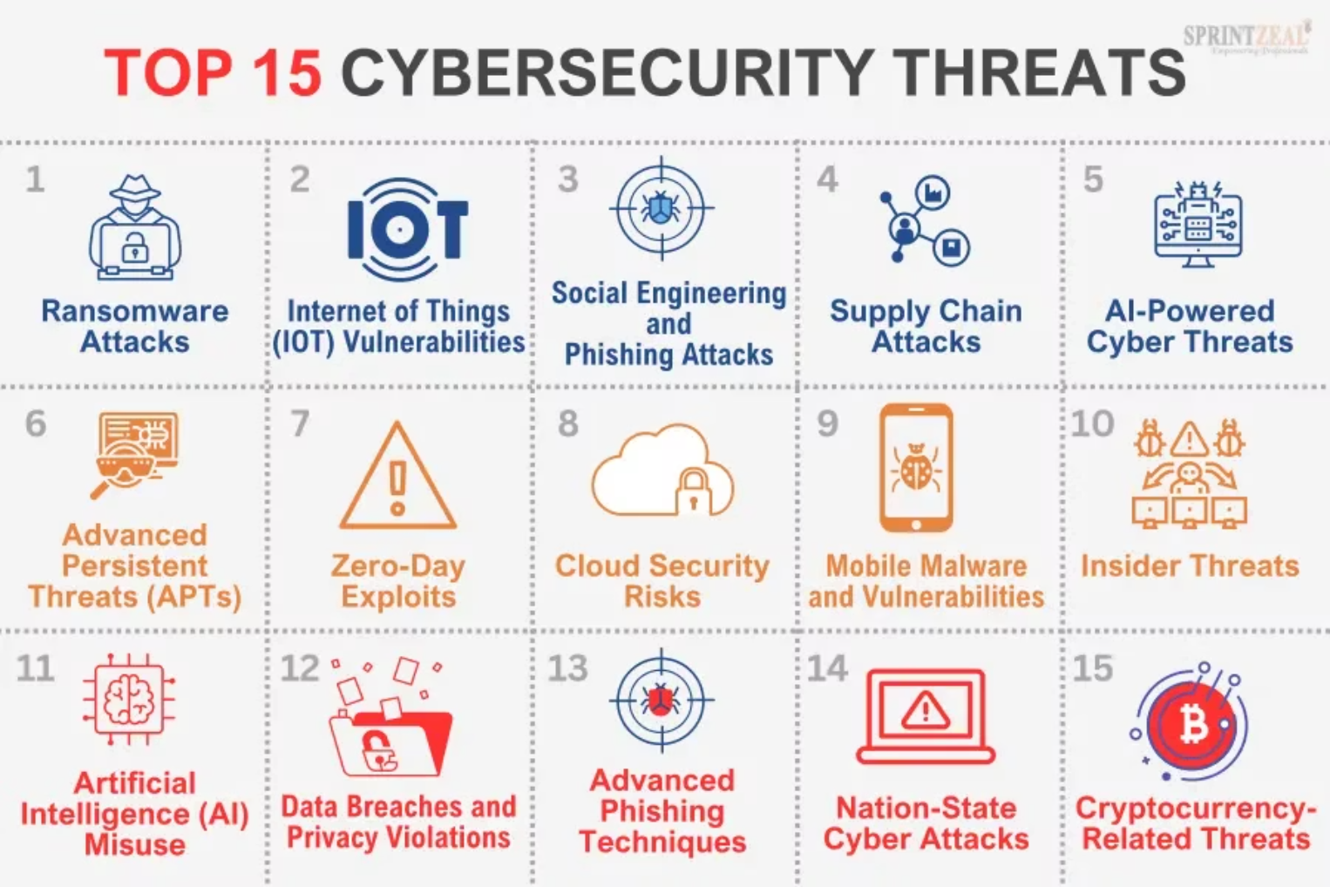
Ransomware Attacks
Internet of Things (IoT) Vulnerabilities
Social Engineering and Phishing Attacks
Supply Chain Attacks
AI-Powered Cyber Threats
Advanced Persistent Threats (APTs)
Zero-Day Exploits
Cloud Security Risks
Mobile Malware and Vulnerabilities
Insider Threats
Artificial Intelligence (AI) Misuse
Data Breaches and Privacy Violations
Advanced Phishing Techniques
Nation-State Cyber Attacks
Cryptocurrency-Related Threats

Slide 13




The Imperative of Cybersecurity
In an increasingly interconnected world, robust cybersecurity is no longer an option, but a fundamental necessity for individuals, businesses, and governments alike. Its importance spans far beyond data protection, touching every aspect of modern operation and trust.
Protecting Critical Assets
Ensuring Business Continuity
Safeguard sensitive data, intellectual property, and essential infrastructure from malicious actors.
Prevent costly breaches, operational disruptions, and system downtime that can cripple organizations.
Preserving Reputation & Trust
Meeting Legal & Compliance
Maintain customer loyalty, stakeholder confidence, and brand integrity in the event of an incident.
Adhere to stringent regulatory mandates and industry standards, avoiding hefty penalties and legal repercussions.

Slide 14
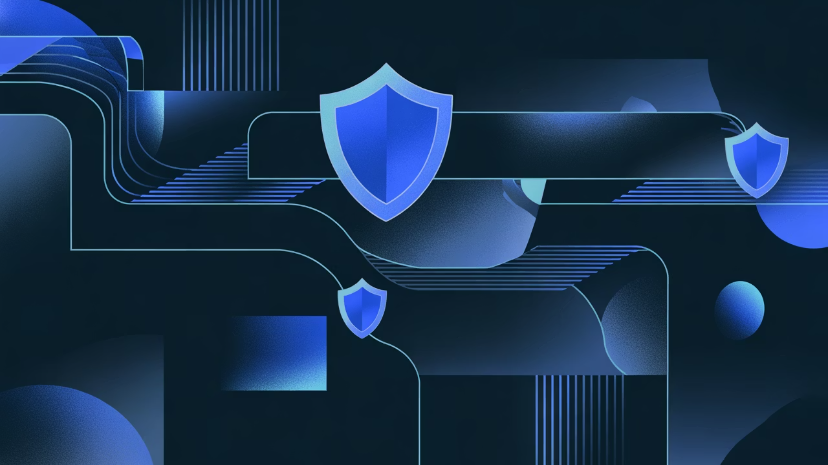
Your Cybersecurity Journey: Key Takeaways
We've explored the essential components of a robust cybersecurity strategy. Keep these pillars in mind as you continue to build and strengthen your organization's defenses:
Evolving Threats
Cloud-Native Focus
Network Defense
Continuously adapt to the dynamic cyber threat landscape and emerging vulnerabilities.
Prioritize security strategies tailored for cloud environments and modern workloads.
Implement comprehensive network security, from perimeter to advanced endpoint protection.
Efficient SOC
Unified Program
Optimize your Security Operations Center with skilled people, clear processes, and smart automation.
Integrate all security domains into a cohesive, continuously improving cybersecurity program.

Slide 15
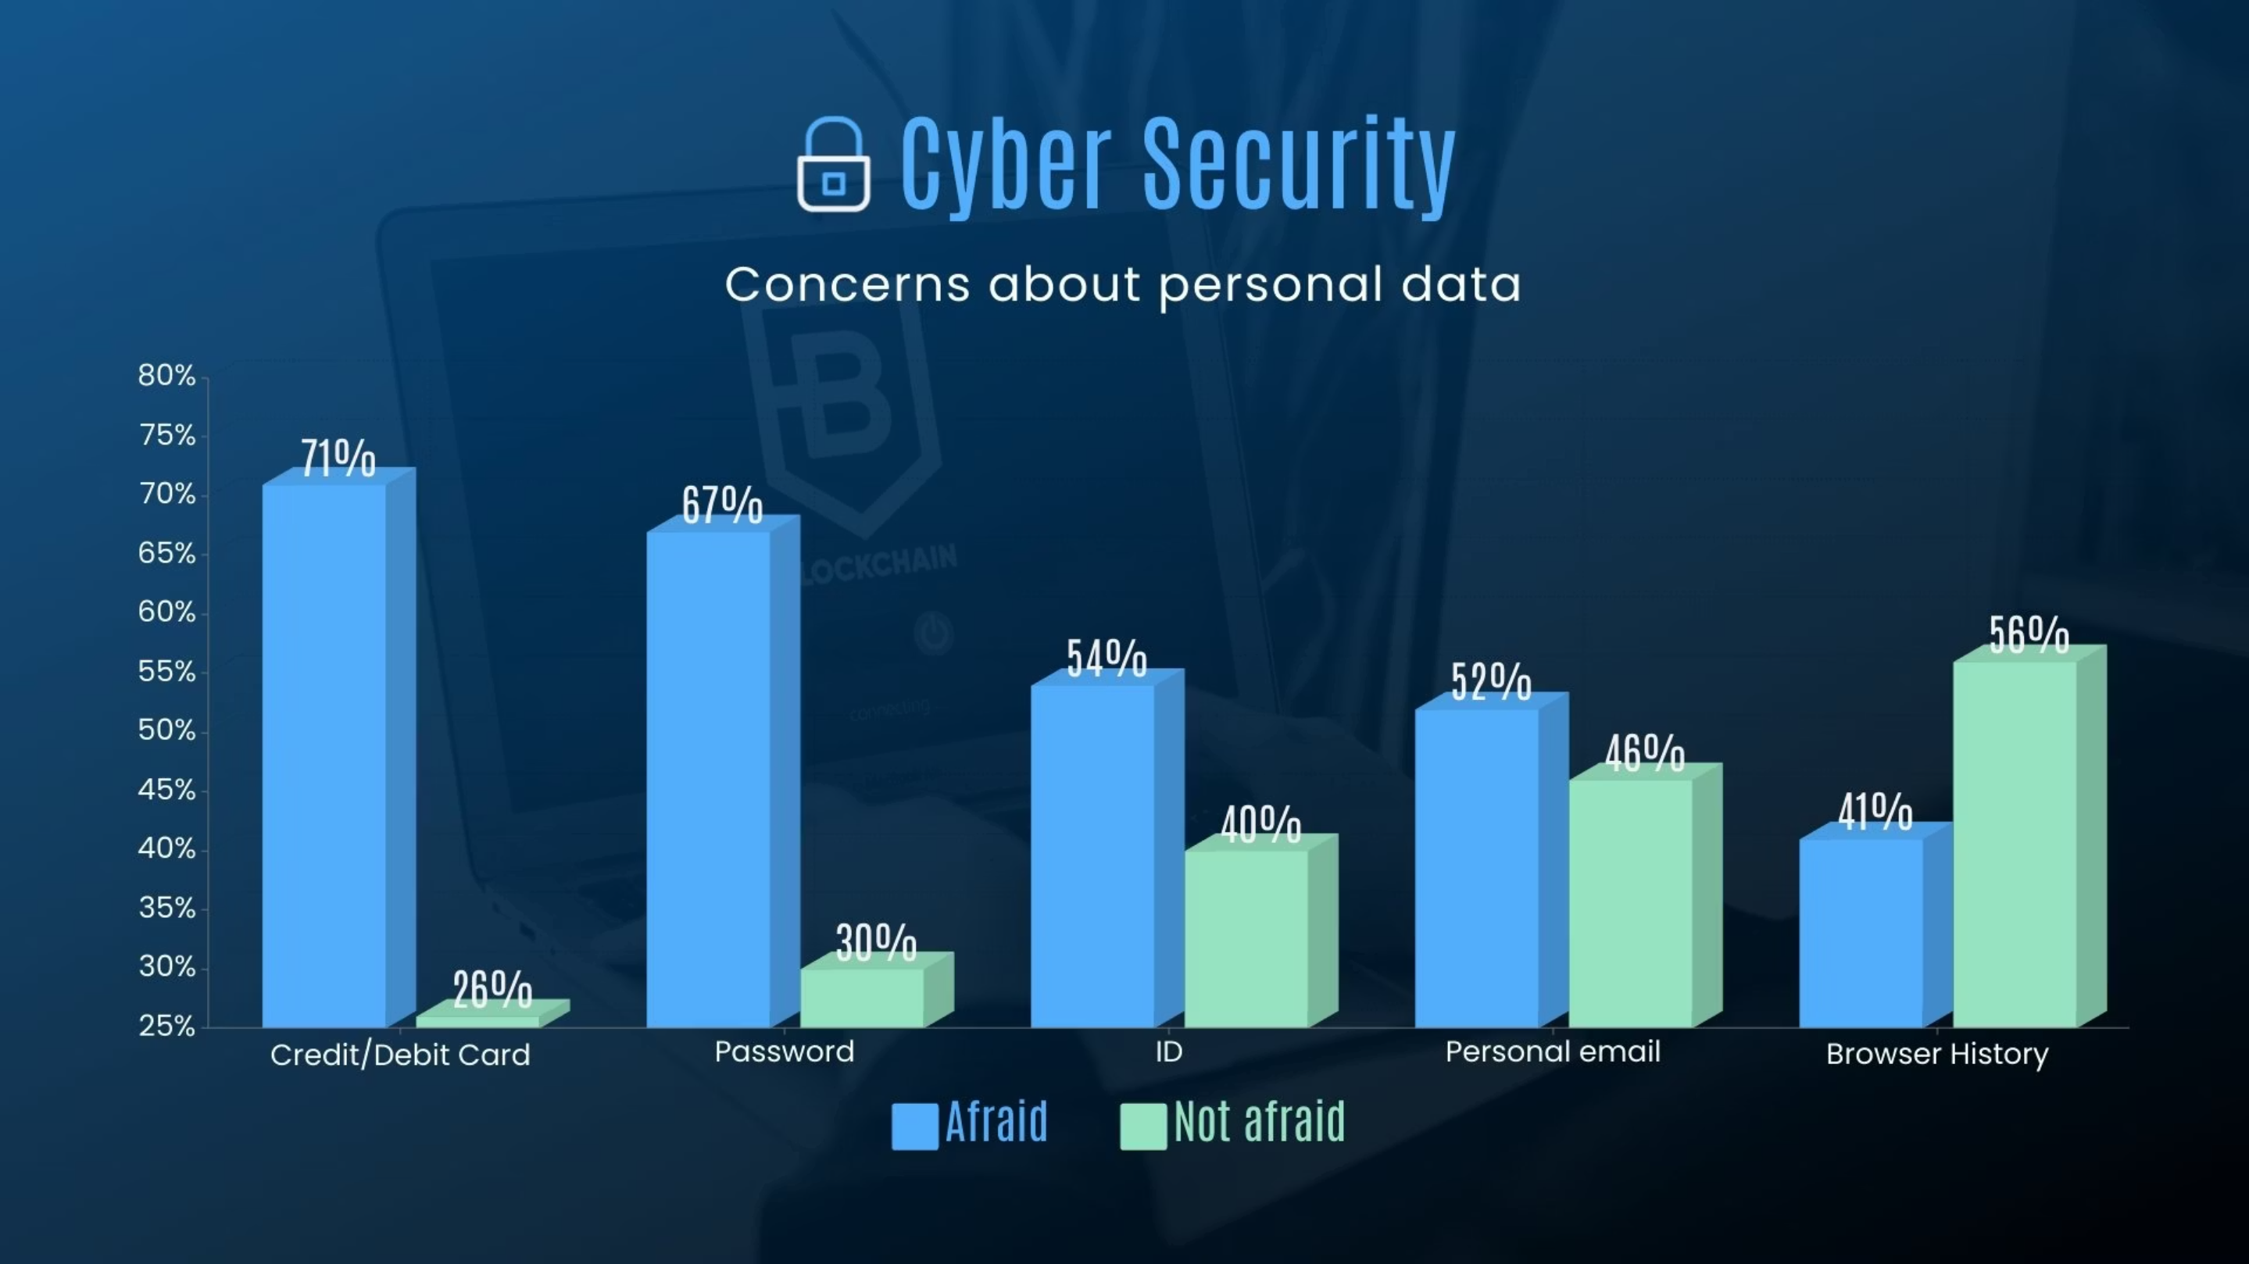

Slide 16
Type of Personal Data
Afraid (%)
Not Afraid (%)
Interpretation
Credit/Debit Card
71%
26%
The majority of people are highly concerned about their financial data being stolen or misused.
Password
67%
30%
Password theft is a major worry since it can lead to unauthorized access to accounts.
ID (Identity Information)
54%
40%
Over half of respondents are worried about identity theft or personal information leaks.
Personal Email
52%
46%
People are nearly equally divided, showing moderate concern about email privacy and data breaches.
Browser History
41%
56%
Fewer people are afraid about their browsing history, possibly because they perceive it as less sensitive.

Slide 17
Thank You

